Slide 1

Metabarcoding data programme
gbif.org/metabarcoding
Notes:
Notes

Slide 2
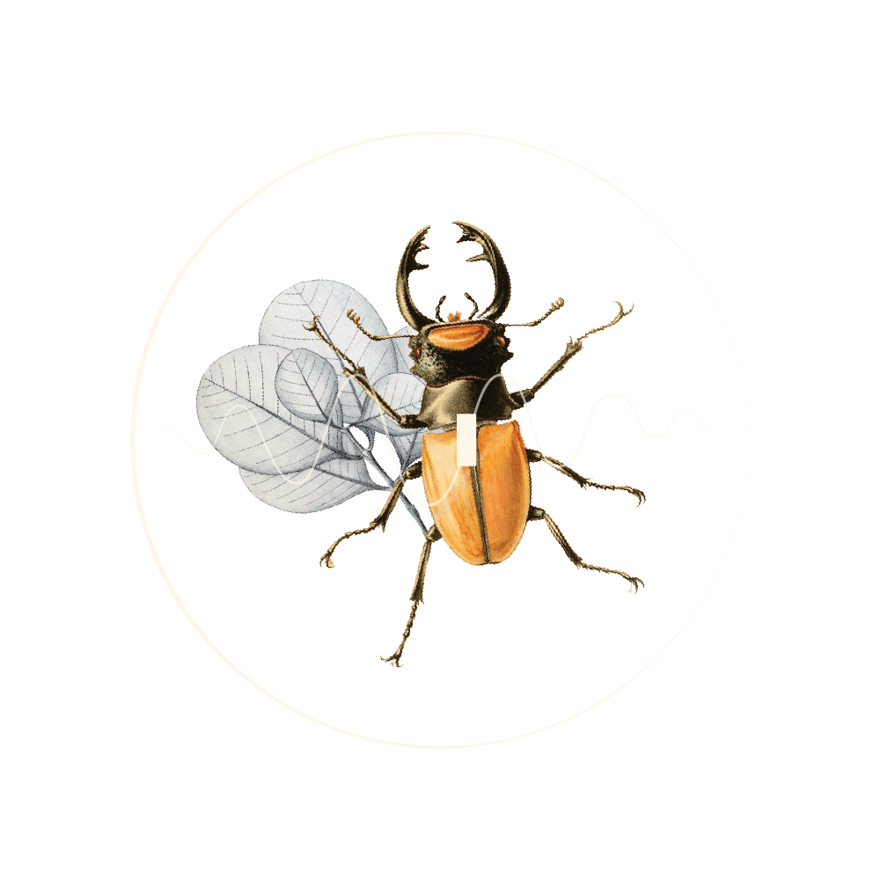
Metabarcoding data programme
Pilot initiative to strengthen links between the GBIF network and DNA metabarcoding data communities while building node capacity for standardizing the publication of biodiversity data through the Metabarcoding Data Toolkit
gbif.org/metabarcoding
Notes:
Notes

Slide 3
Metabarcoding data programme
The objective of this programme is to empower GBIF nodes to support and mobilize DNA metabarcoding data within their own networks. Programme activities will include not only testing and refining the MDT to meet the needs of both nodes and users, but also providing nodes with training to administer the tool, refining and translating guidance materials, and aligning workflows for metabarcoding data with the GBIF network's structures and practices.
gbif.org/metabarcoding

Slide 4

Try out the demo version
Publishing mode: In this mode, users can register datasets with GBIF on behalf of their organizations. The Metabarcoding Data Toolkit functions like an IPT, operating as a platform for publishing hosted datasets directly by GBIF.
Conversion-only mode: In this mode, users can prepare their datasets using the MDT but the processed datasets/archive must be download and published through other channels, such as a GBIF IPT installation. This mode is suitable for scenarios where data holders are undecided whether to have GBIF host their datasets or not.
gbif.org/metabarcoding
Notes:
Notes

Slide 5
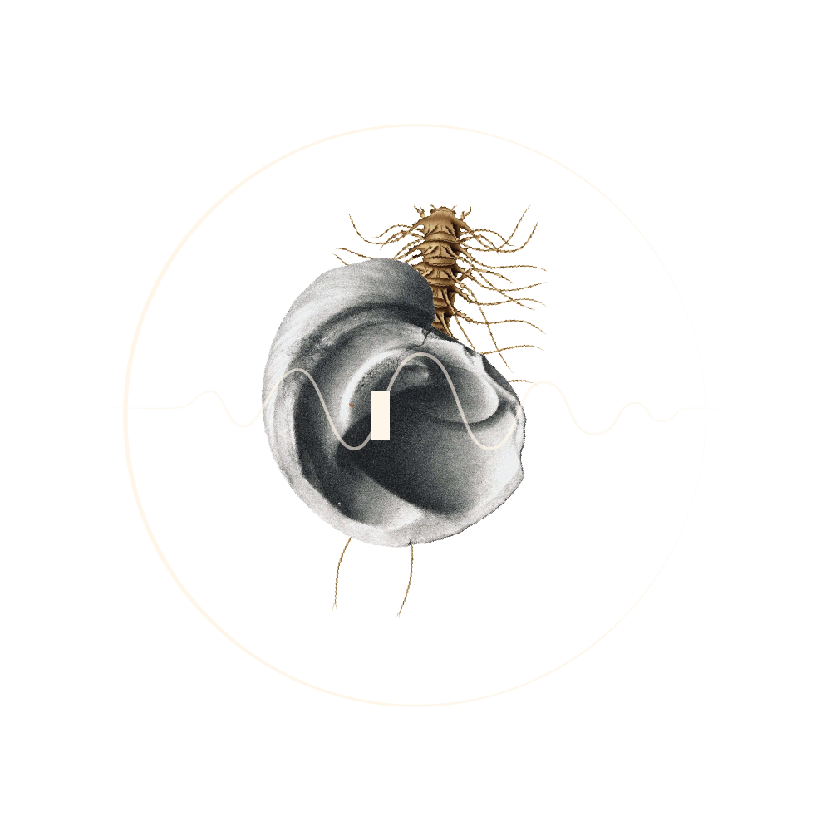
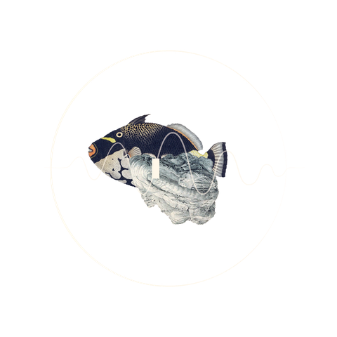
Overview of the pilot phase
What does the MDT do?
What we hope to achieve
Commitments for participating in the pilot phase
gbif.org/metabarcoding
Notes:
1. What does the MDT do? The Metabarcoding Data Toolkit simplifies the process of publishing DNA metabarcoding data to GBIF using familiar templates that map data to standardized terms. The MDT also helps data holders add static values, accommodate non-Darwin Core fields, and review data accuracy through visualizations.
In addition to accessing a comprehensive guide containing videos, example datasets and FAQs, MDT users can prepare dataset metadata with a simple form and export their data in a format suitable for publication through GBIF.org.
2. What do we hope to achieve? The objectives of the pilot phase are to strengthen the network's engagement of the metabarcoding data community and build the capacity of GBIF's nodes to manage this type of data. The GBIF Secretariat will focus on refining the MDT in response to user feedback and finalizing the set of templates for data holders.
The Secretariat is committed to preparing additional documentation and training materials, exploring integration with R and Python scripts, and outlining best practices for deploying the MDT.
3. Commitments for participating in the pilot phase. GBIF nodes that join the MDT pilot are expected to publish data from a network of metabarcoding data holders, provide the GBIF Secretariat with feedback for refining the tool and its guidance materials, and join quarterly webinars. They should also ensure that datasets published during the programme's pilot phase remain accessible on GBIF.org, even if installations are relocated or the programme concludes.

Slide 6

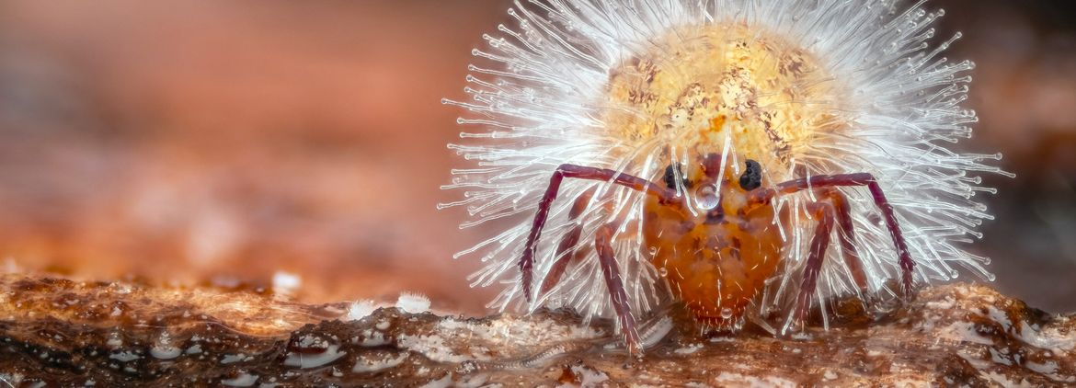

Metabarcoding data-related resources
GBIF nodes invited to join pilot for DNA metabarcoding data on biodiversity
GBIF briefing on Digital Sequence Information (DSI)
Metabarcoding Data Toolkit – user guide
gbif.org/metabarcoding
Notes:
Notes

Slide 7

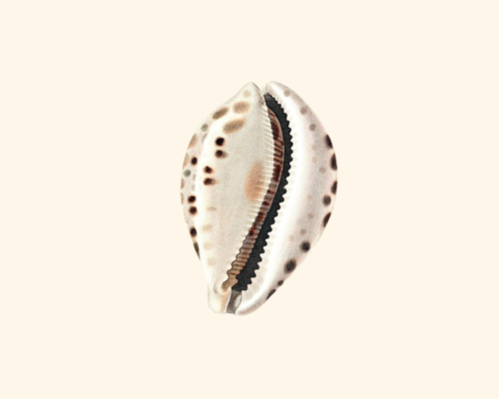


Featured metabarcoding datasets
Eukaryotes detected in marine water (collected July 2023) from the North Atlantic by the MSC Poesia cruise ship; inferred from 18S DNA metabarcoding data.
eDNA from water column to characterise fish and invertebrate communities from 30 sites in the Belgian Part of the North Sea -COI
COI data from: Environmental DNA metabarcoding differentiates between micro-habitats within the rocky intertidal (Shea & Boehm, 2024)
Comparison of Environmental DNA and SCUBA Diving Methods to Survey Keystone Rockfish Species on the Central Coast of British Columbia, Canada
gbif.org/metabarcoding
Notes:
Notes

Slide 8
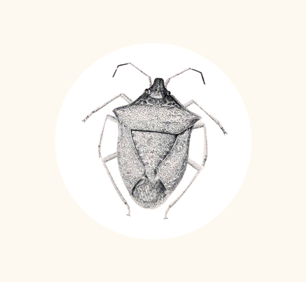

Agreements and terms of use
GBIF data user agreement
GBIF hosted repository service
gbif.org/metabarcoding
Notes:
Notes

Slide 9

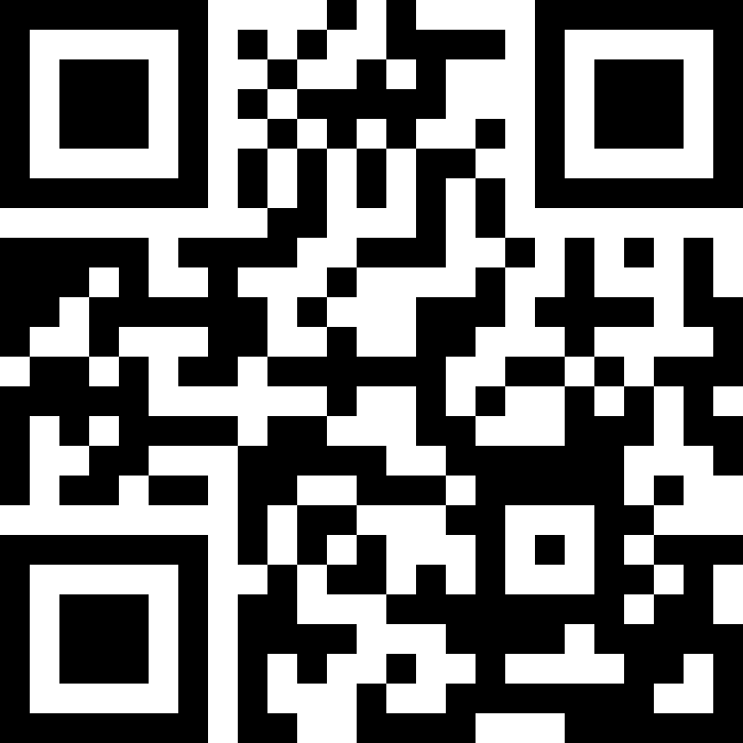
Metabarcoding data programme
The development of this tool has received funding from the European Union's Horizon Europe research and innovation programme under grant agreement No 101057437 (BioDT project, https://doi.org/10.3030/101057437)
Learn more!
gbif.org/metabarcoding

